Slide 1
Towards the knowledge-based society @ SEIp Lab
Tihana Galinac Grbac
Goran Mauša

Slide 2
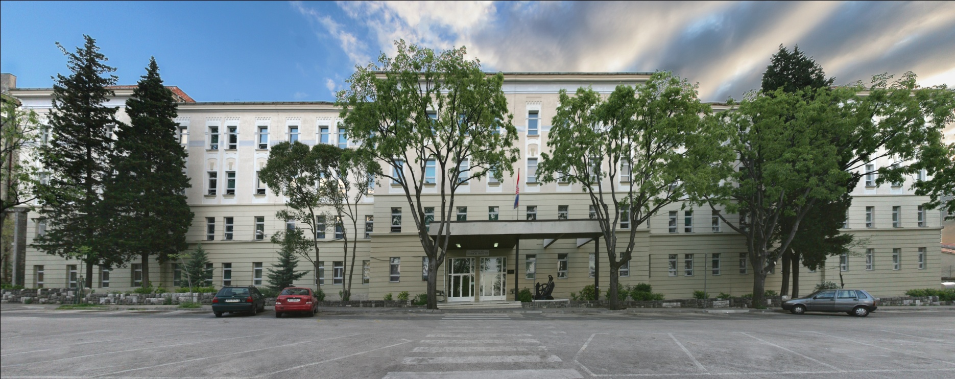
Who are we?

Slide 3
Faculty of engineering university of rijeka
1960. Faculty of Mechanical Engineering
1969. Faculty of Mechanical Engineering and Naval Architecture
1973. Faculty of Engineering
Study programmes @ Faculty of Engineering
Mechanical Eng. (Bachelor’s and Master’s degree)
Naval Eng. (Bachelor’s and Master’s degree)
Electrical Eng. (Bachelor’s and Master’s degree)
Computer Science
2007 Bachelor's degree
2011 Master’s degree
Doctor degree in Engineering Sciences
Notes:
Nowadays the Faculty of Engineering numbers
88 permanent employees in scientific teaching, teaching and associate vocations,
35 junior researchers,
46 associate lecturers and assistants, and
51 administrative employees and technical personnel.
The Faculty scientists carried out a lot of scientific research projects financed by the state, as well
as development projects for the needs of the economy. Some of the scientists have
received town, national and international awards for their work.
As the only higher education institution for the education of graduate engineers,
engineers, masters and doctors of engineering sciences in the area of three Northern
Adriatic Counties of Croatia (Primorsko-Goranska, Istarska and Ličko-Senjska),
The following figures testify to this fact: 2191 graduate
engineers of Mechanical Engineering, 284 graduate naval architects, 117 graduate
engineers of Electrical Engineering, 673 mechanical engineers, 94 naval engineers, 653
electrical engineers, 92 Masters of Science and 76 Doctors of Science in the field of

Slide 4
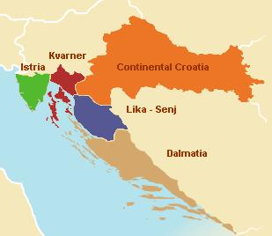
Students and perspective
Mostly from North-Adriatic counties
Around ten thousands of economy
and other subjects faced with
clear necessity of employing
information, communication
and computer educated personnel
Global need for ICT educated
personnel
Notes:
The initiative for launching the university undergraduate study of Computer Science at
the Faculty of Engineering, University in Rijeka has been taken in order to satisfy the
needs for such profile of professionals especially in the region of
Primorsko-Goranska,
Istarska and
Ličko-Senjska Counties.
These three north-Adriatic counties predominantly
gravitating toward the University of Rijeka are estimated to have some ten thousands of
economy and other subjects. They are all faced with the clear necessity of employing
computer-trained personnel, which is especially evident in some three hundreds of great
and average sized companies and social subjects, having an indispensable need for
application, maintenance and information system development. According to these
indicators, the number of information and computer educated personnel in the region of
these three counties goes beyond 1000.

Slide 5
Organization of department of computer Engineering
Research Groups:
Communication Systems Group
Intelligent Computing Systems Group
Software Engineering Group
Laboratories:
Artificial Perception and Autonomous Systems Lab
Communications and Network Systems Lab
Laboratory for Applications of Information Technologies
Software Engineering and Information Processing Lab (SEIP Lab)

Slide 6
Software engineering and information processing Lab
What should be the main goals for SE Laboratory?
Our Mission is
the synergy of research and education in the field of software engineering and information processing.
the research motivated by the collaboration with other research groups and the real problems and needs through the collaboration projects with industry partners
Providing practical experience and challenges, these collaboration projects with industry strongly support the education of young scientists and professionals in the field
Notes:
As I have already mentioned the main motivation for the new study in CS was need for proffesionals in that area. So

Slide 7
Organization of seip lab
interfaces
courses
SEIP Lab
Researchers
Plan
Experiment
Do
Experiment
Check
Validate results
Act
Disseminate
Students
Introduction to soft computing and applications
Mälardalen University
PhD students
Collaborator institutions
Software engineering
management
Web application development
Elective projects 1, 2
University of Zageb
Graduate
students
ERASMUS
projects
Ericsson Nikola Tesla
Summer camp
Software engineering
Undergraduate
students
Regional SMEs, goverment, etc.
Student projects
repository
Industry projects
repository

Slide 8
SEIP Lab – Started in 2011
Knowledge based society is a society that creates, shares and uses knowledge for the prosperity and well-being of its people
To be able to act in that manner we have to:
Develop interfaces to
Our collaborators
Between researchers and students
To repositories for systematic data collection
Develop services for
Research process (based on PDCA cycle)
Education
Industry
Share team spirit and discuss ethical rules

Slide 9
OUR expertise
Leading software process improvements in global companies (Lean, Six Sigma, CMMI)
Moving to global software development (processes and tools)
Verification of complex systems (how to organize verification and correction process)
Modeling of complex systems (developing system rules for the benefit of system evolution, maintain)
Implementing reliability
Next generation movement in networks and related technologies

Slide 10
Research interests
Behavior of complex systems
Reliability and evolvability
Search based software engineering
Verification of complex systems
Software Process Improvements
Software Engineering Management

Slide 11
Our selected publications
Galinac Grbac, T., Runeson, P., Huljenić, D., A Second Replicated Quantitative Analysis of Fault Distributions in Complex Software Systems, IEEE Transactions on Software Engineering, 10.1109/TSE.2012.46
Galinac Grbac, Tihana, Car, Željka, Huljenić, Darko, Quantifying Value of Adding Inspection Effort Early in the Development Process: a Case Study, IET Software, 3 (2012), 6, pp. 249-259.
Mauša G., Galinac Grbac T., Dalbelo Bašić B., Multivariate Logistic Regression Prediction of Fault-proneness in Software Modules, Proceedings of the International Conference on Telecommunications and Information of MIPRO 2012, pp. 813-818
Galinac Grbac T., Huljenić, D., Defect Detection Effectiveness and Product Quality in Global Software Development, Lecture Notes in Computer Science, Vol. 6759, 2011, pp. 113-127
Galinac, T., Empirical Evaluation of Selected Best Practices in Implementation of Software Process Improvement, Information and Software Technology, Vol. 51, No. 9, 2009, pp. 1351-1364
Galinac, T., Car, Ž., Software Verification Process Improvement Proposal Using Six Sigma, Lecture Notes in Computer Science, Vol. 4589, 2007, pp. 51-64

Slide 12
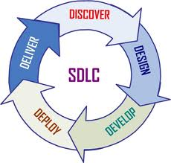
Student projects
Software development for telecommunication services
Mobile applications(Android)
Services for mobile, Internet and next generation networks
Topics: social inclusion, educative mobile games, ambient assisted living, m-health applications
Application of modern technologies
Word Wide Web Consortium (W3C)
Web Services Interoperability Organization (WS-I)
Organization for the Advancement of Structural Information Standards (OASIS)
....
Experience software development lifecycle,
teamwork, software quality issues, etc.
Use of open source IDE
Eclipse, NetBeans

Slide 13
Our collaborators
So far we have formal collaboration with
Ericsson Nikola Tesla
Malardalen University, Sweden
Faculty of electrical engineering and computing, University of Zagreb

Slide 14
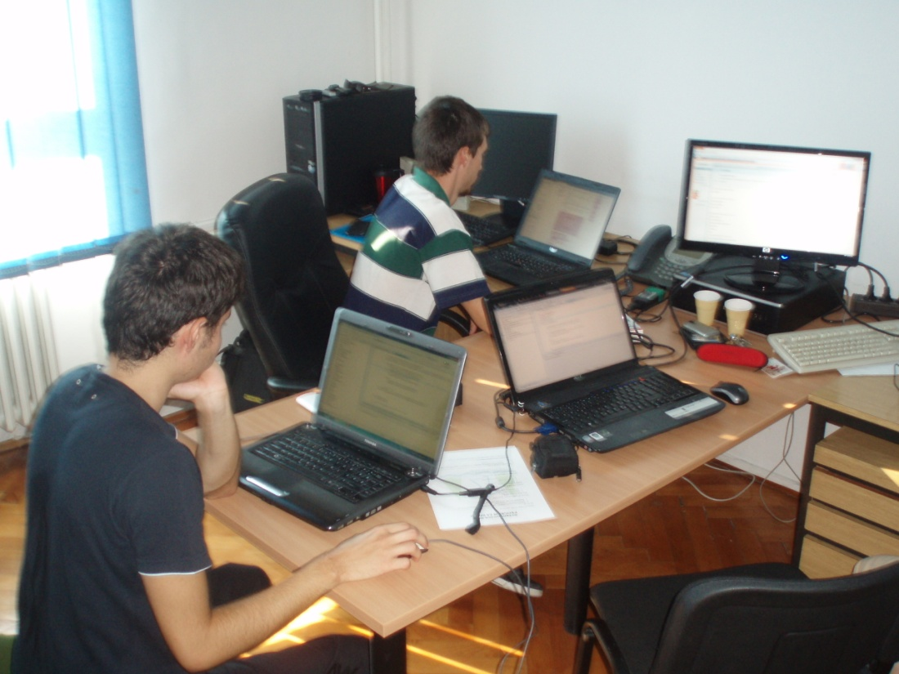
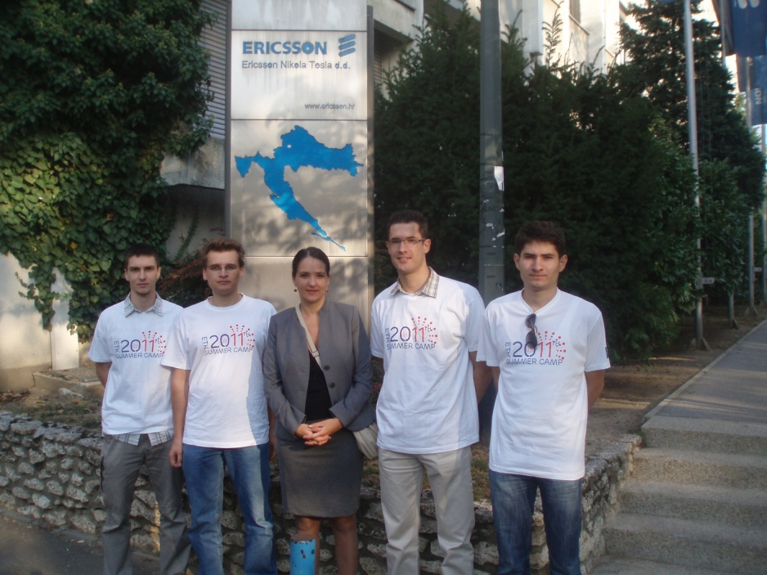
BEST Practice - Summer camp industry collaboration

Slide 15
Questions?

